Slide 1
Designing and Analysis of Algorithms Course Code: ECS 5101/CS514
Dr Rahul Mishra
IIT Patna
Lecture 11

Slide 2
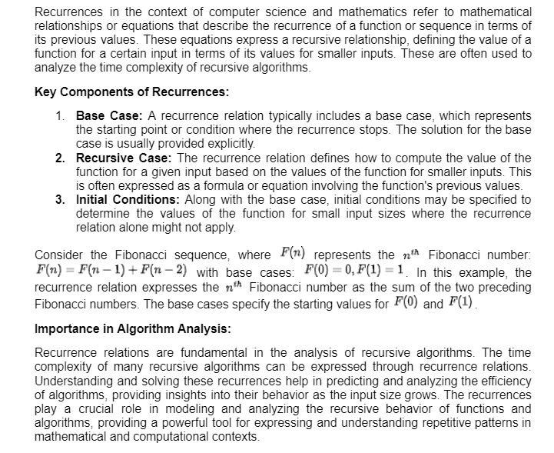
Recurrences

Slide 3
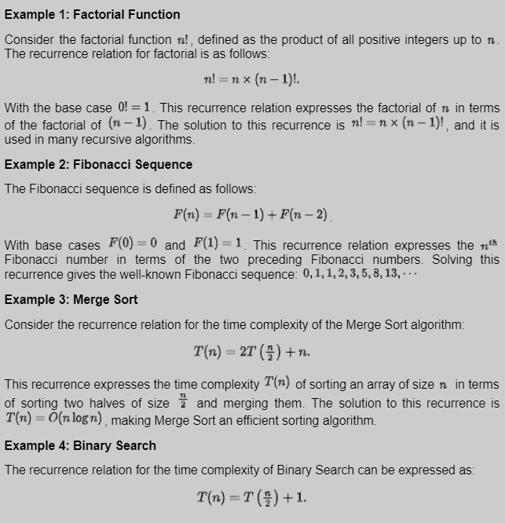
Recurrences

Slide 4
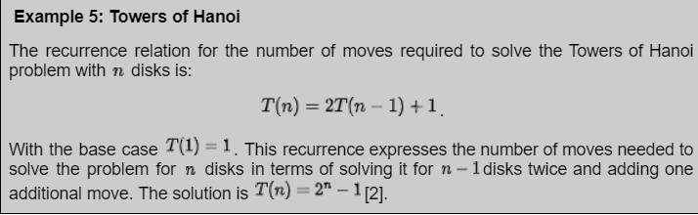
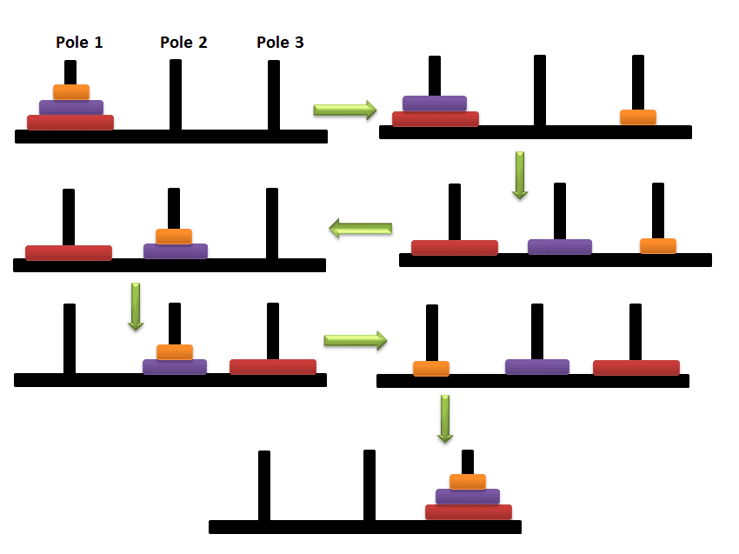
Recurrences
Detailed in Stack Chapter

Slide 5
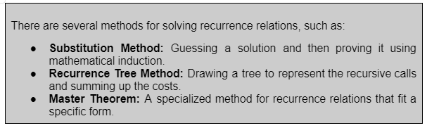
Recurrences

Slide 6
Master Theorem
The master method is a formula for solving recurrence relations of the form:
T(n) = aT(n/b) + f(n),
where, n = size of input
a = number of sub-problems in the recursion
n/b = size of each sub-problem.
All sub-problems are assumed to have the same size. f(n) = cost of the work done outside the recursive
call, which includes the cost of dividing the problem and the cost of merging the solutions
Here, a ≥ 1 and b > 1 are constants, and f(n) is an asymptotically positive function.
An asymptotically positive function means that for a sufficiently large value of n, we have f(n) > 0.

Slide 7
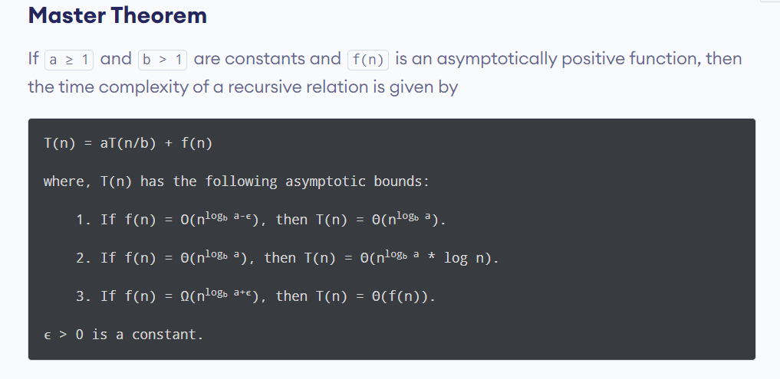

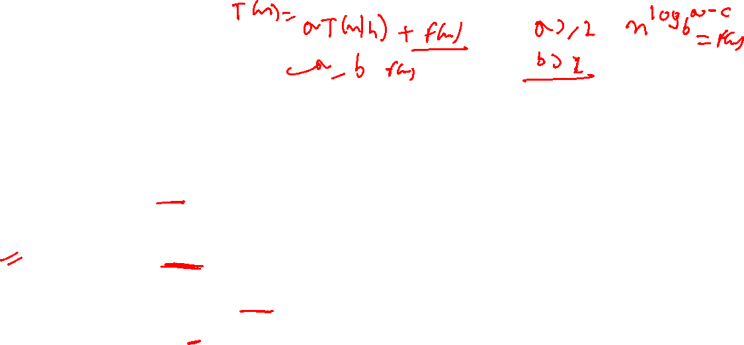
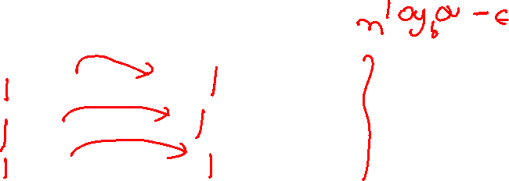
Master Theorem

Slide 8
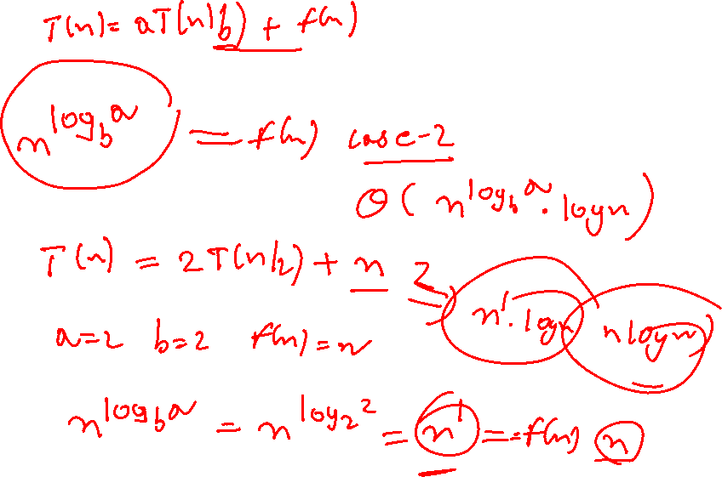

Slide 9
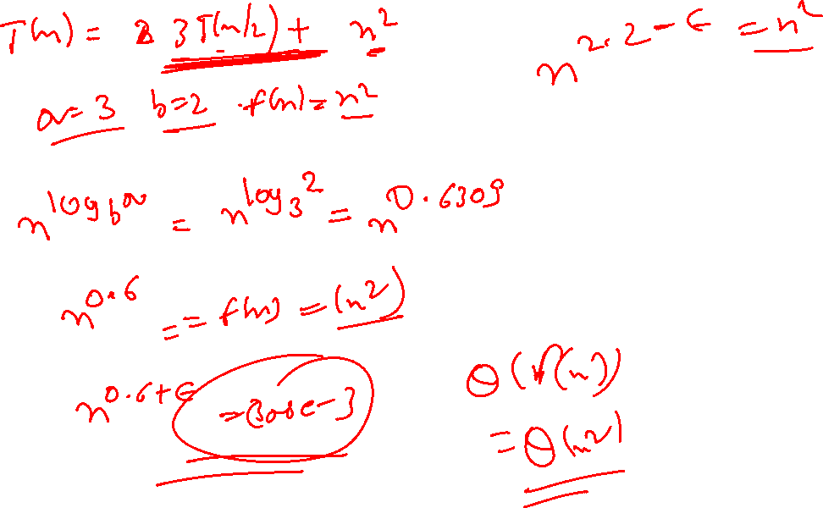

Slide 10
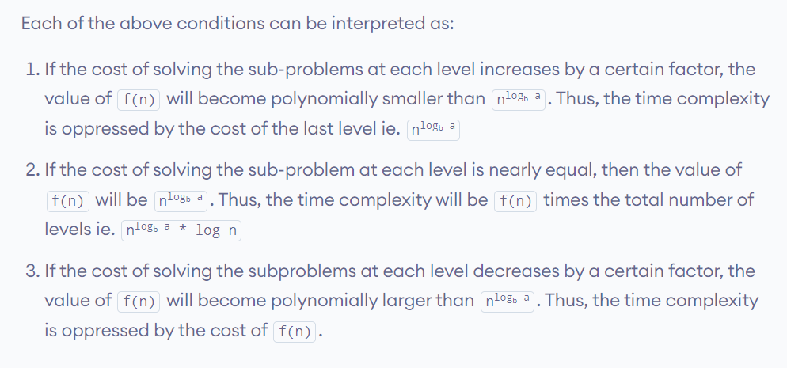
Master Theorem

Slide 11
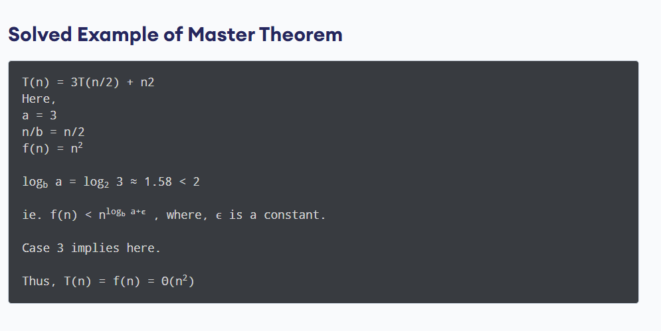
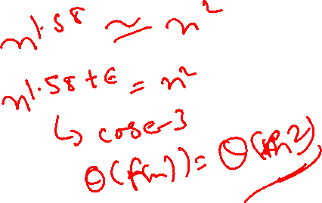
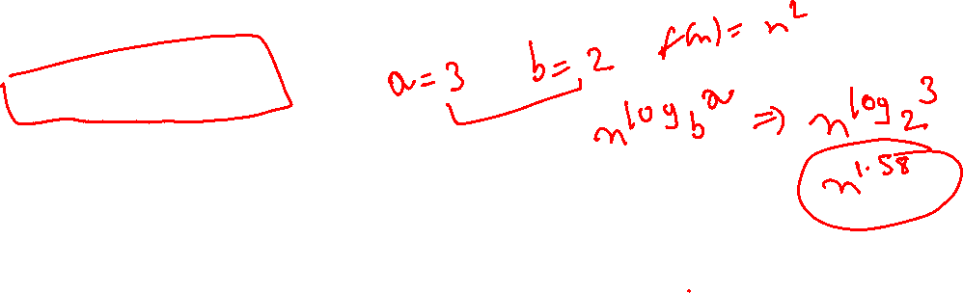
Master Theorem
n^2

Slide 12
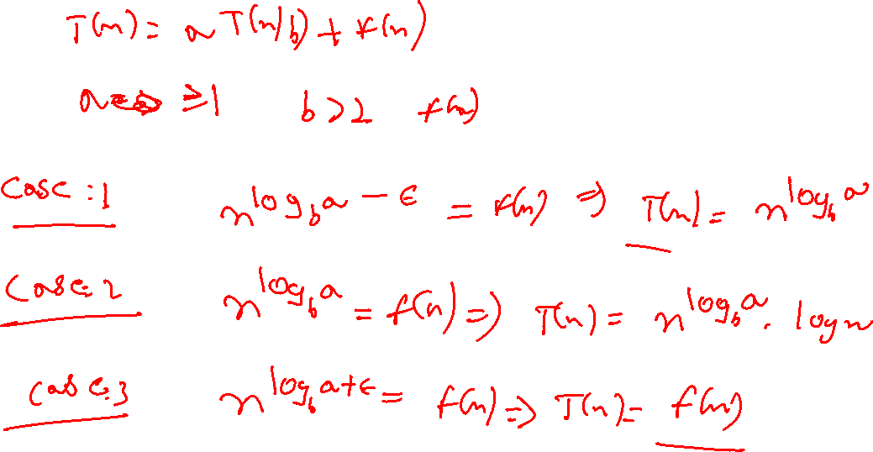

Slide 13
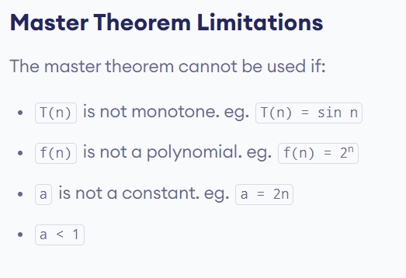
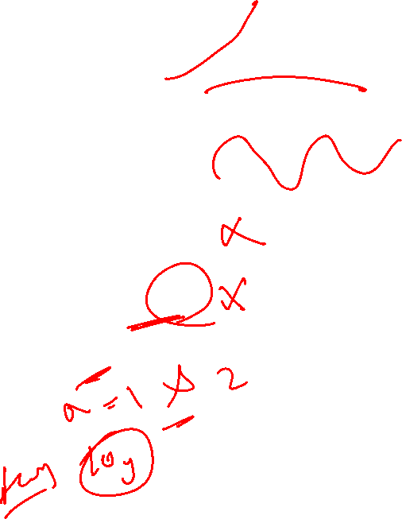
Master Theorem

Slide 14
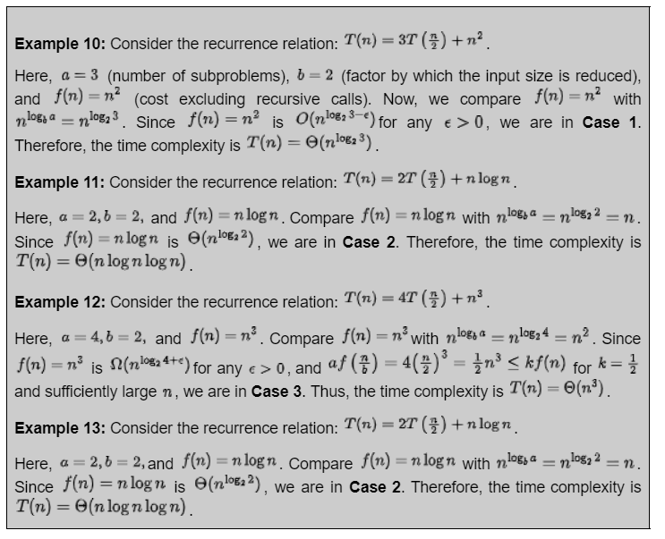
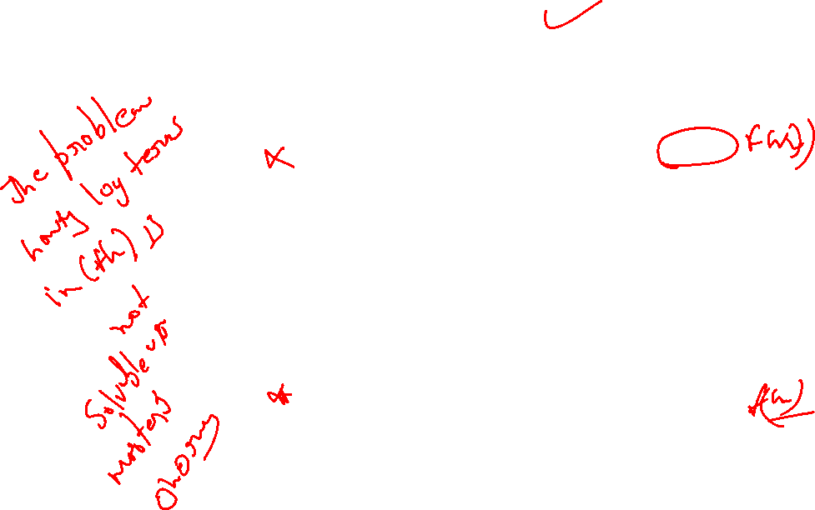

Slide 15
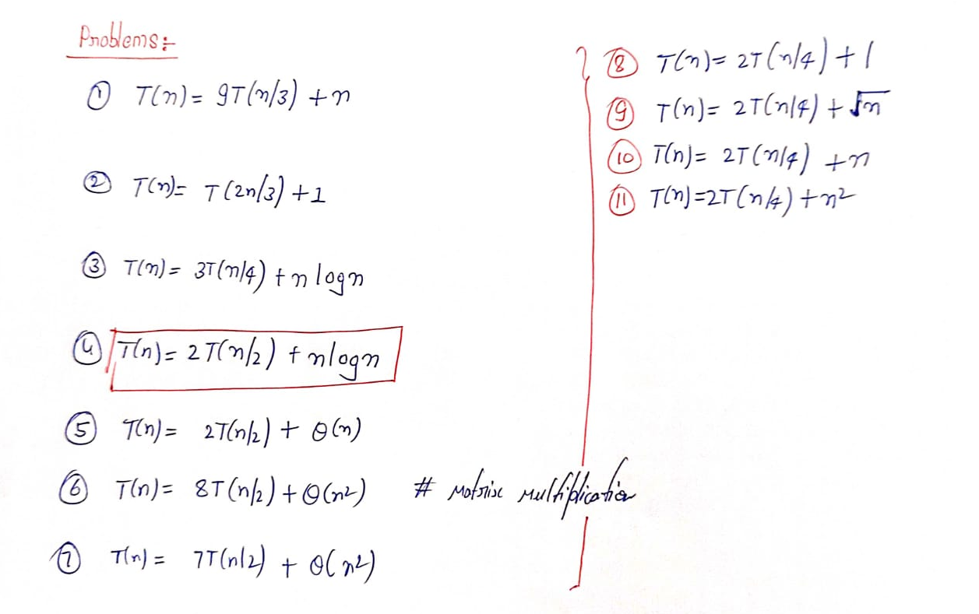


Slide 16
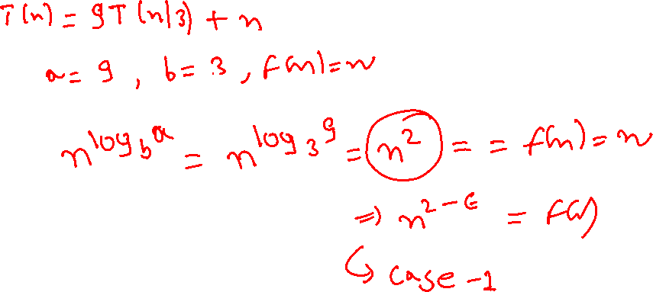
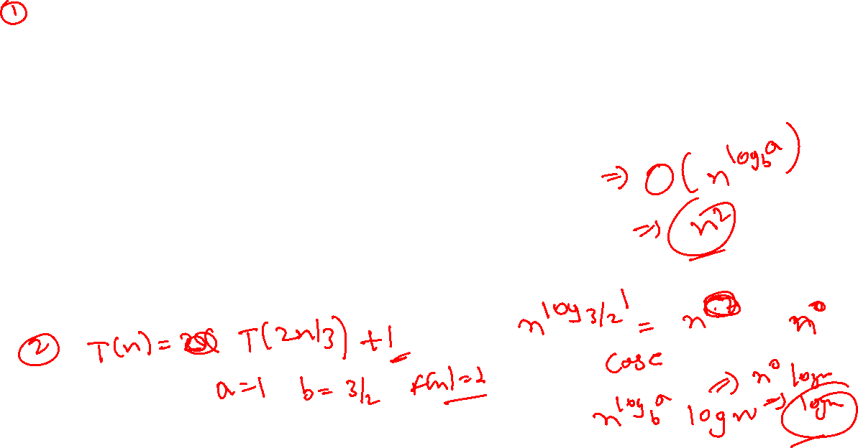

Slide 17
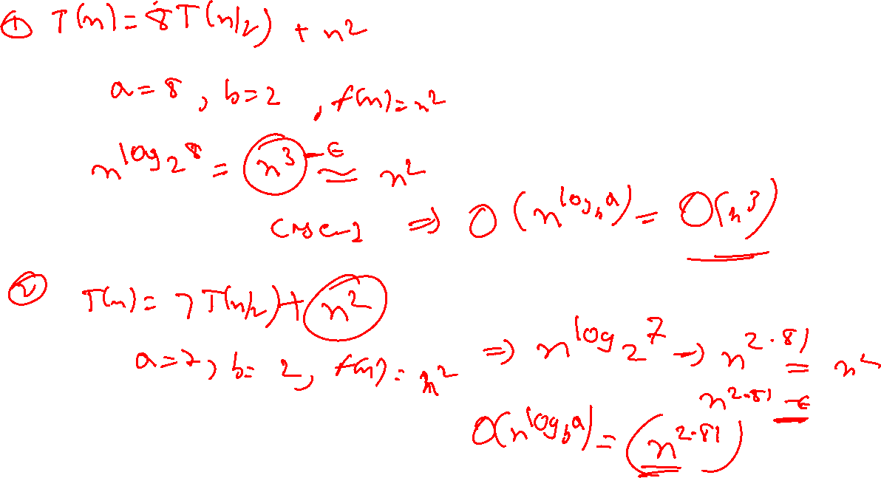

Slide 18
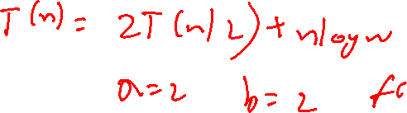

Slide 19
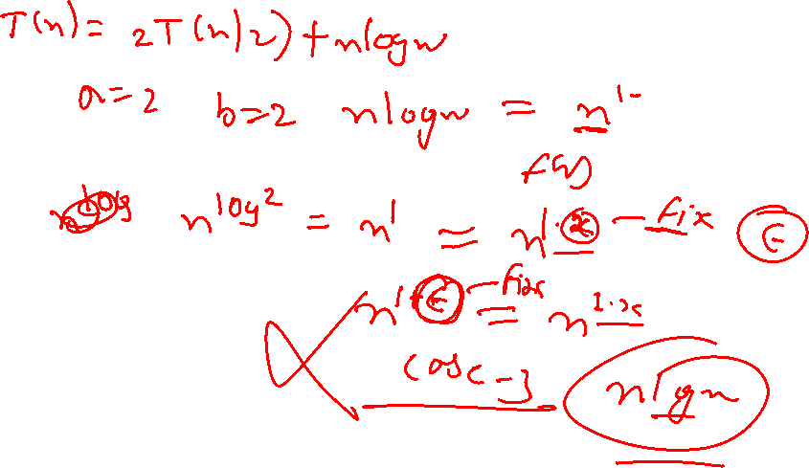

Slide 24





Slide 25
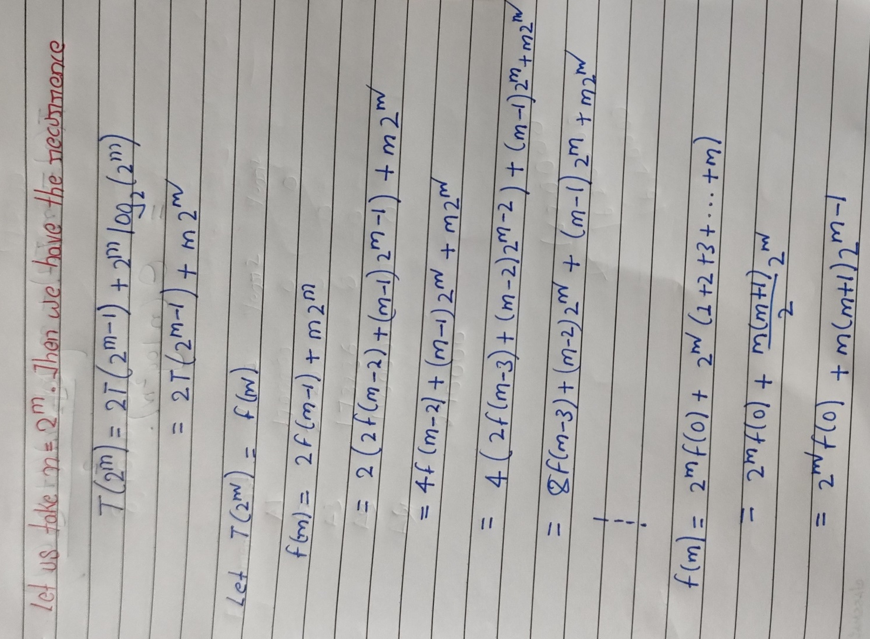
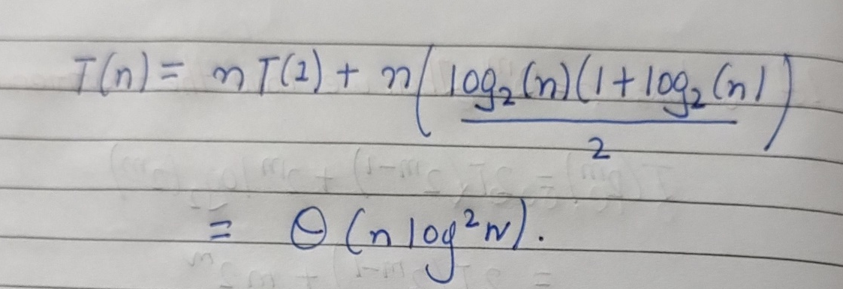
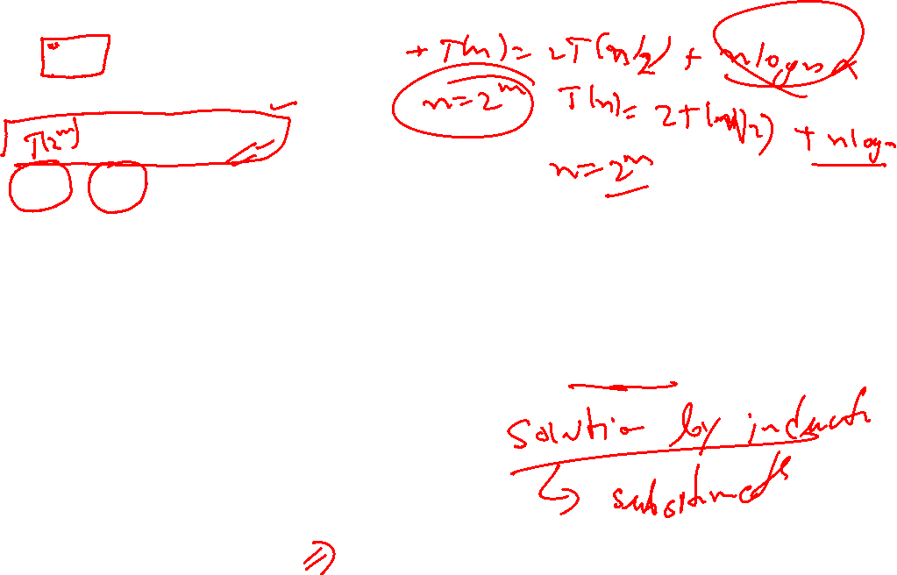

Slide 26
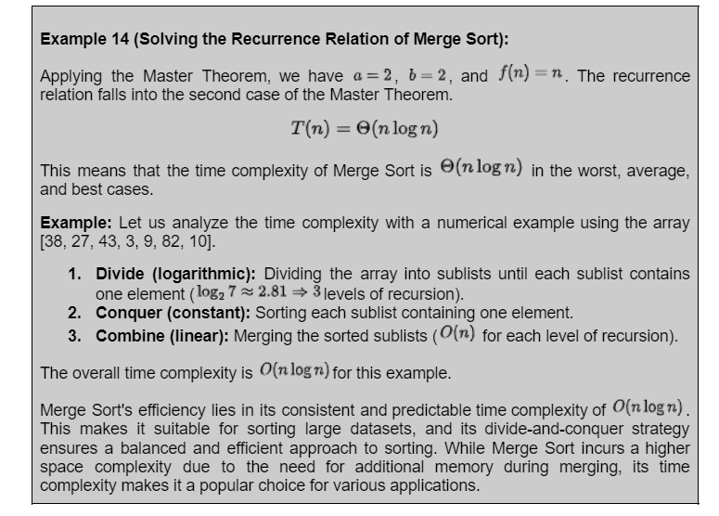

Slide 27
